Slide 1
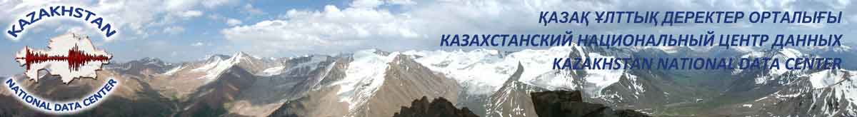
Kazakhstan National Data Center
(KazNDC)
Pavel Ryabenko

Slide 2
The main tasks of KazNDC are:
Data acquisition and transfer from the IGR network stations;
Data exchange with International and National Centers;
Processing of all arrived data in different operation modes;
Scientific researches in the field of seismology, seismic acoustic, geodynamics etc.

Slide 3
IMS FACILITIES
LOCATION | TYPE | TREATY CODE | STATUS
Makanchi | Primary Seismic Station (AR) | PS23 | Certified
Borovoye | Auxiliary Seismic Station (AR) | AS057 | Certified
Kurchatov | Auxiliary Seismic Station (AR) | AS058 | Certified
Aktyubinsk | Auxiliary Seismic Station (3C) | AS059 | Certified
Aktyubinsk | Infrasound Station | IS31 | Certified

Slide 4
Data processing at KazNDC:
Operator-analysts in KazNDC work on continuous basis, 24 hours a day, 7 days a week.
The following bulletins are created:
1. Automatic bulletin, delay – 20-30 minutes to one hour;
2. Interactive regional bulletin, delay – 1 day;
3. Joint (with SEME MES RK) interactive regional bulletin, delay – 1 – 1.5 days;
4. Bulletin etype, delay – several months.
.

Slide 5
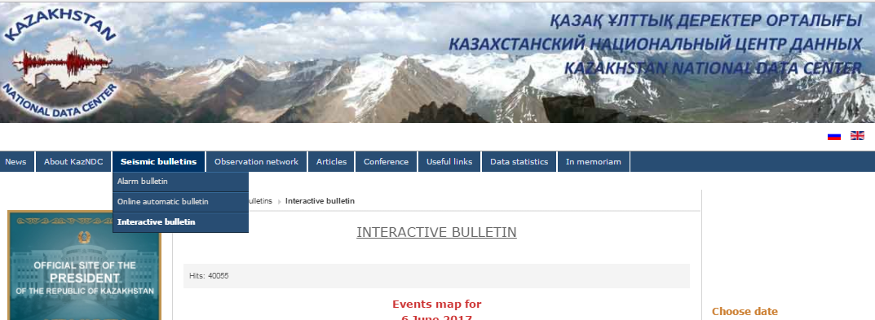
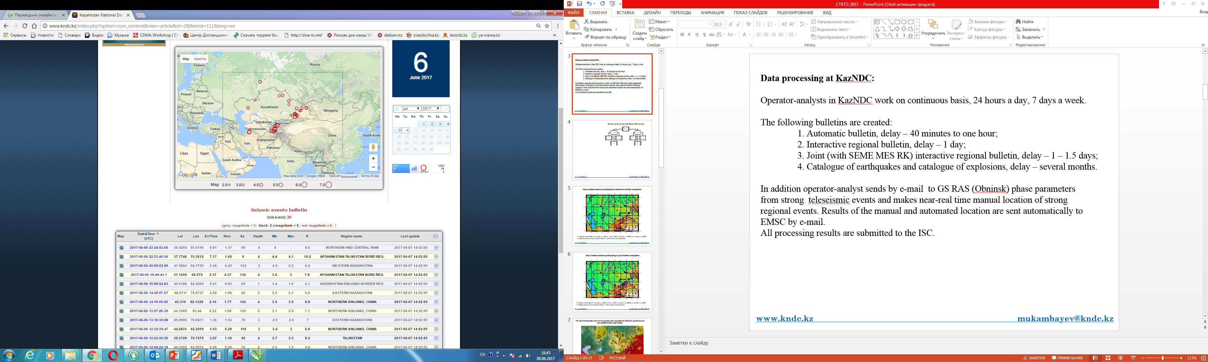
Website of KNDC

Slide 6
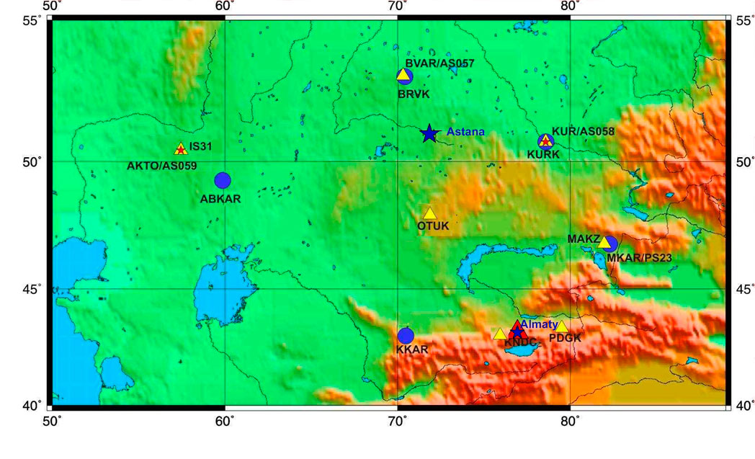
At the present time the IGR observation network includes 5 seismic arrays, 7 three-component stations and 3 infrasound stations.
Seismic arrays
3-component stations
Infrasound stations

Slide 7
Map of seismic stations participating in interactive bulletin compilation
AS057
IS31
AS058
AS059
PS23
1- seismic arrays IGR; 2 - 3 comp. s.s. IGR; 3 - infr. s. IGR 4- 3 comp. s.s. SEME; 5- 3 comp. s.s. KNET;
6- Alibek seismic array (Turkmenistan); 7- ZAL sesimic array (Russia)

Slide 8
Map of seismic stations participating in joint bulletin compilation
AS057
IS31
AS058
AS059
PS23
1- seismic arrays IGR; 2 - 3 comp. s.s. IGR; 3 - infr. s. IGR 4- 3 comp. s.s. SEME; 5- 3 comp. s.s. KNET;
6- Alibek seismic array (Turkmenistan); 7- ZAL sesimic array (Russia)

Slide 9
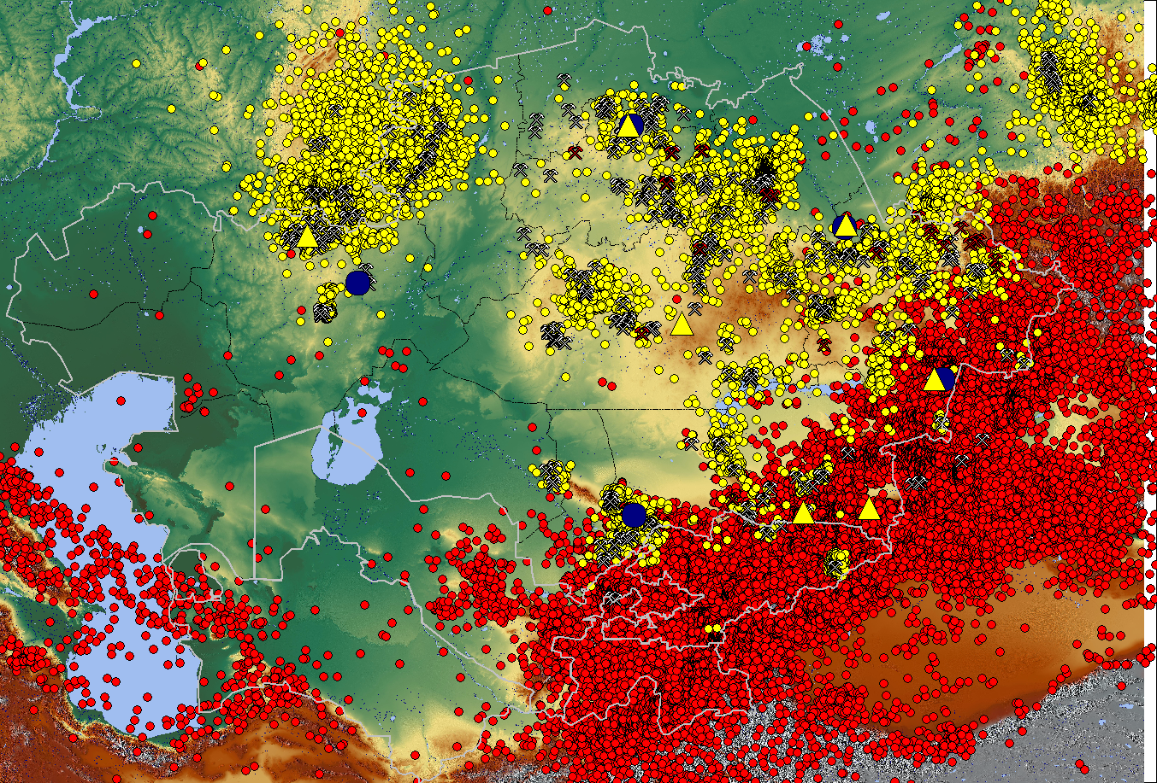
The map of earthquakes (red) and mining blasts (yell.) epicenters for 2006-2016 according to the joint KazNDC bulletin (total 194000)
- 3 comp. s.s. IGR;
- seismic arrays ;
- mines

Slide 10
KazNDC cooperates with different International and foreign Data Centers on regular basis, among them are:
International Data Center (IDC, Vienna, Austria);
European Mediterranean Seismological Centre (EMSC, Paris, France);
International Seismological Center (ISC, England);
National Data Center of the USA (USNDC, Florida, USA);
Incorporated Research Institutions for Seismology (IRIS, USA);
Data Center of Geophysical Service of Russia (GS RAS, Obninsk, Russia);
Norway Seismological Center (NORSAR);
German Research Centre for Geosciences ( GFZ, Potsdam, Germany) etc.
Kyrgyzstan National Data Center
Head of KazNDC – Dr. Mikhailova Natalya.

Slide 11












International cooperations
LDEO Columbia
University
GS RAS
IS AS KR

Slide 12
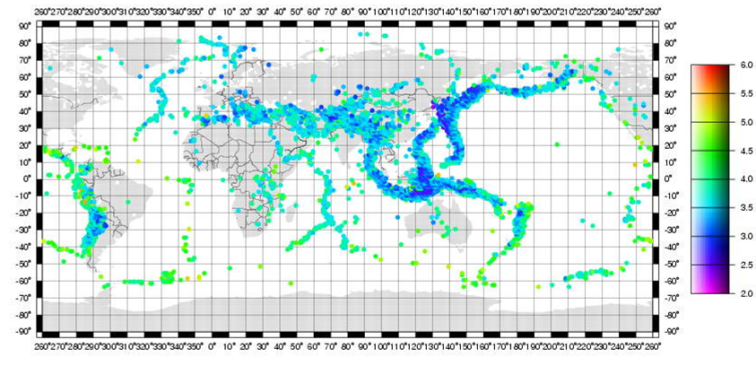
Contribution of Kazakhstan stations belonging to IMS network into REB
PS23
Contribution of Kazakhstan primary station Makanchi of the IMS into REB
Contribution of Kazakhstan stations belonging to
the auxiliary network of the IMS into REB compilation

Slide 13
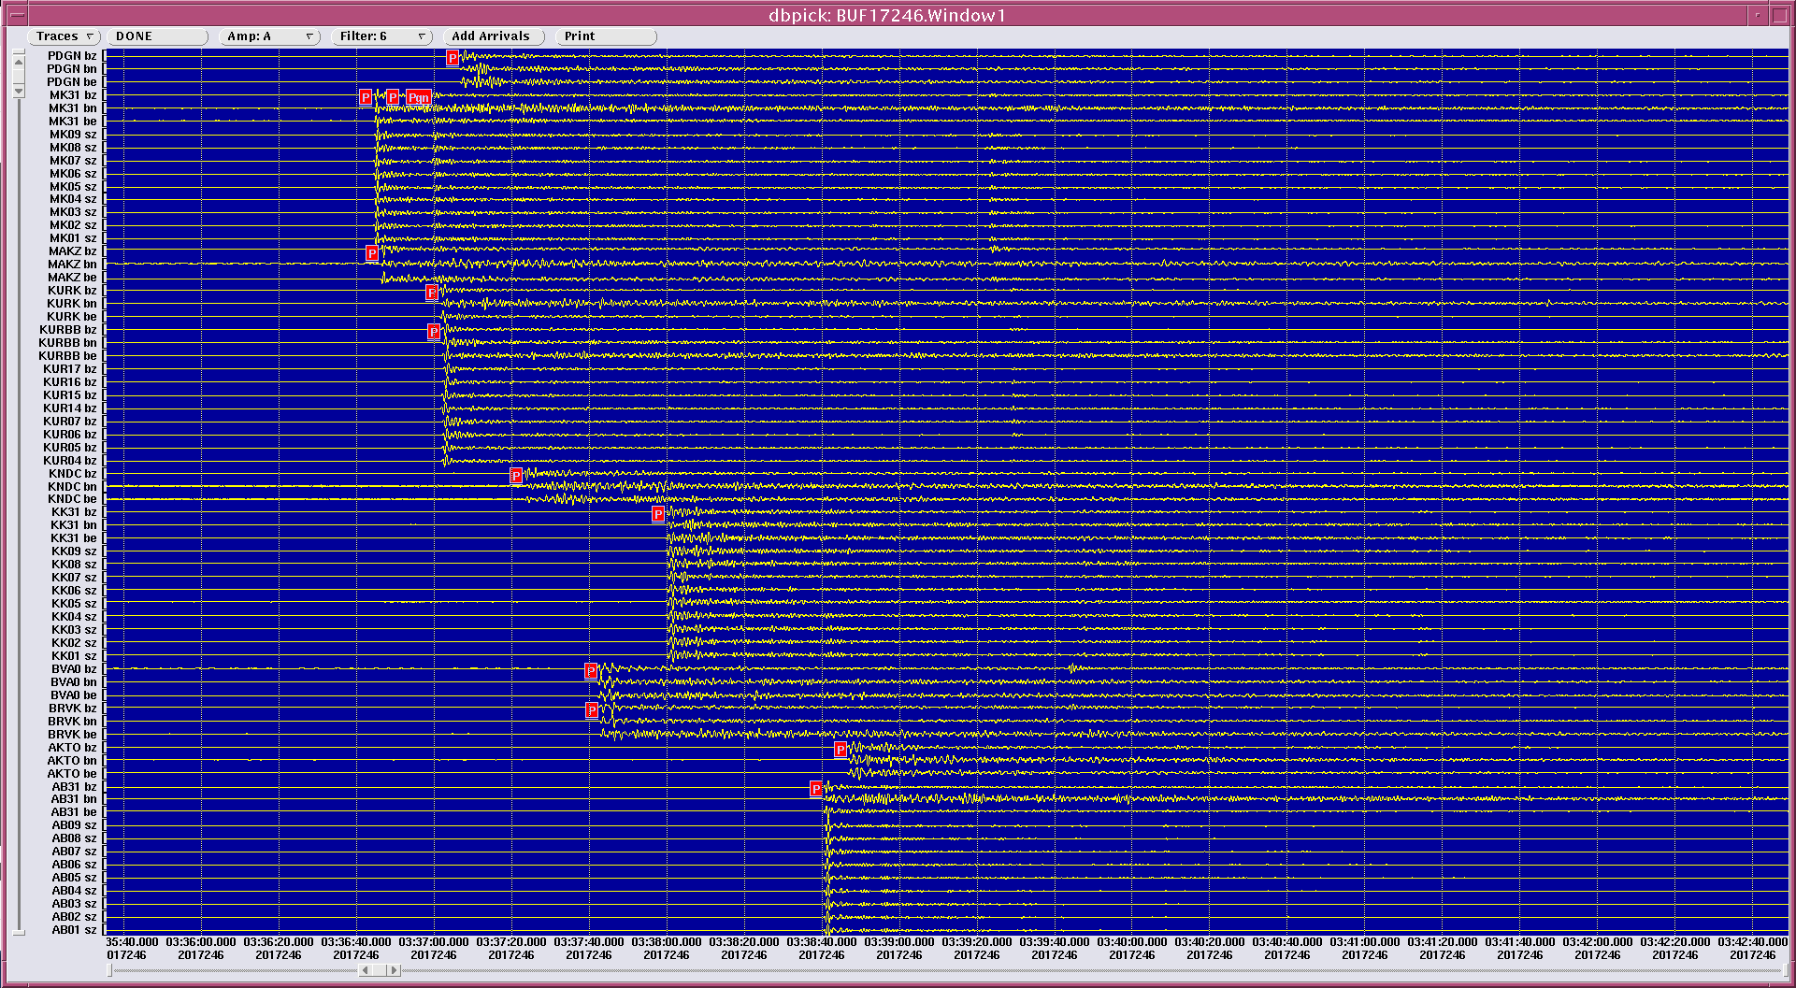
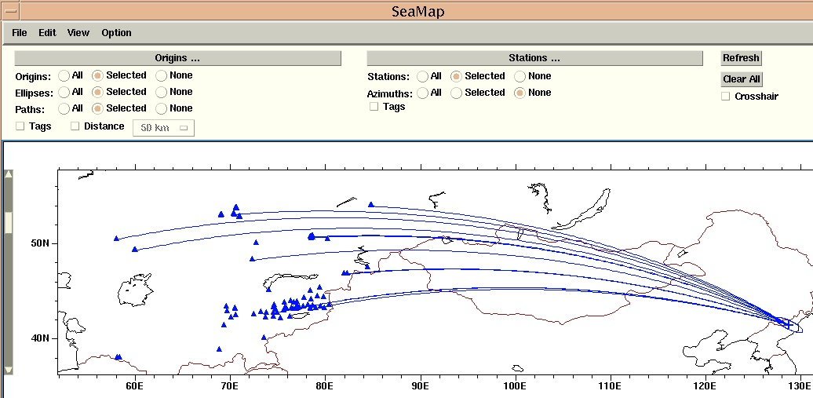
Nuclear test at Punggye-ri (North Korea) 03-Sep-2017.
Дата | Время | Сев. Широта | Вост. Долгота | mb | Станции, зарегистрировавшие ПЯВ | Δ, км | Азимут станция-ПЯВ
10/09/2006 | 01:35:28.0 | 41.294 | 129.094 | 4.3 | KUR, ZRNK, VOS, CHKZ, BRVK, ABKAR | 3746-5310 | 72.1 - 85.1
05/25/2009 | 00:54:43.3 | 41.306 | 129.029 | 4.7 | MKAR, KURK, KUR, VOS, BRVK, BVAR, ZRNK, ABKAR, AKTO, CHKZ, KNDC, KKAR, | 3746-5310 | 72.1 - 85.2
02/12/2013 | 02:57:51.4 | 41.308 | 129.076 | 5.1 | ABKAR, AKTO, BRVK, BVAR, KKAR, KURK, KUR, MAKZ, MKAR, OTUK, PDGK, KNDC | 3746-5401 | 72.2 - 89.8
06/01/2016 | 01:30:01.5 | 41.308 | 129.049 | 5.1 | AKTO, ABKAR, BRVK, BVAR, KKAR, KUR, KURK, KNDC, MAKZ, MKAR, OTUK, PDGK | 3726-5373 | 71.9 - 85.3
09/09/2016 | 00:30:02 | 41.3230 | 128.9870 | 5.3 | AKTO, ABKAR, BRVK, BVAR, KKAR, KUR, KURK, MAKZ, MKAR, OTUK, PDGK | 3746-5401 | 71.9 - 85.3
03/09/2017 | 03:30:06 | 41.4494 | 129.0810 | 5.7 | AKTO, ABKAR, BRVK, BVAR, KKAR, KUR, KURK, MAKZ, MKAR, OTUK, PDGK, KNDC. | 3737-5390 | 71.3 - 82.2

Slide 14
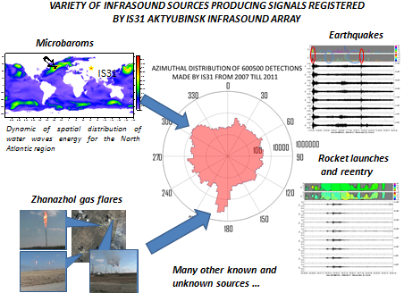

Slide 15
THANK YOU FOR ATTENTION!
KazNDC
Postal address:
050020
Kazakhstan
Almaty,
Chaikina str. 4
Tel: +7 (727) 263-13-30
Fax: +7 (727) 263-48-82
Email: ndc@kndc.kz
Web:www.kndc.kz

